Slide 1

Capstone Project
Vishal Verma 0820949
Rajandeep Singh 0813403
Amanpreet Kaur 0816950
Prof Savita Seharawat

Slide 2
Abstract Air travel has become an integral part of modern society, connecting people and facilitating global commerce. To cater to this demand, airports around the world have emerged as essential hubs of transportation. This project presents a comprehensive dataset obtained from the collaborative efforts of the OurAirports.com community, a platform where aviation enthusiasts and experts contribute valuable data.

Slide 3
The dataset comprises detailed information on airports from various countries, including essential attributes such as codenames, elevation, frequency, runways, and Wikipedia links. The codenames provide unique identifiers for each airport, streamlining communication and navigation in the aviation industry. Elevation data allows pilots to make informed decisions during takeoff and landing, considering the surrounding terrain and weather conditions.

Slide 4
Furthermore, the dataset includes frequency information, which is vital for air traffic control and communication between pilots and air traffic controllers. This data enables seamless coordination and ensures safe and efficient air travel operations. The detailed specifications of runways, such as their lengths and orientations, play a pivotal role in aircraft landing and takeoff procedures, ensuring optimal safety and performance.

Slide 5
Objective
This abstract provides an overview of the key themes and approaches in AIRPORTS.
Questions
Which airports are bigger and smaller according to runways.
In which airport has maximum and minimum latitude and longitude deg has.
To what extent does the dataset cover airports in remote or less well-documented regions, and how does it contribute to improving air travel accessibility in such areas?
In what ways does the availability of codenames and their unique identifiers impact communication and standardization in the aviation industry?
Check which ISO region has heliport.
Keywords: Machine learning, classification, predictive modeling, cross validation, k-Means clustering.

Slide 6
We will explore the dataset using excel, furthermore, we used the python for data preprocessing EDA and data modeling. Github Source: https://github.com/jiwanjinat/capstone-worldairports

Slide 7
Introduction:
In this project we are looking to analyze the different airport runways estimates. We would find the growing field that utilizes advanced data analytics and machine learning techniques to extract valuable insights from the worldairport data and enhance the quality of the airports.

Slide 8
Literature Review
In this project we are using the dataset of different airports in all over the world .
The data is based on distinct runways .The dataset is created
on august 8, 2021 and is updated on June 7,2023.
It is provided by the community ie: ourports.com.The dataset contains record of runway_length_ft
runway_width_ft
runway_surface
runway_lighted
runway_closed

Slide 9
Methodology
The workflow to build a model:
Data preprocessing
Exploratory data analysis (EDA)
Experimental Design
Models implementation and evaluation
Conclusion

Slide 10
we would divide the dataset into training and testing parts which would be used to predict the quality of the airporta in US. We would explore the dataset using excel, furthermore, we would use python for data preprocessing EDA and data modeling.

Slide 11
Data preprocessing
Data preprocessing is a crucial step in the data analysis and machine learning workflow. It involves transforming raw data into a format suitable for analysis or modeling, ensuring that the data is accurate, consistent, and ready for further processing. Proper data preprocessing can significantly impact the performance and accuracy of machine learning models. Here are some common techniques used in data preprocessing:

Slide 12
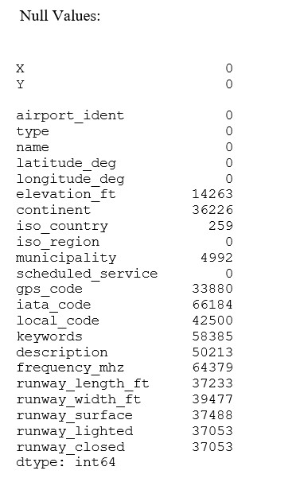

Slide 13
For this project we replace the null values with mean. As, Mean imputation is suitable for numerical data types, such as integers or floating-point numbers. Mean imputation is a simple approach; it is not always the best choice. Other imputation techniques, such as median imputation, regression imputation may be more suitable depending on the nature of the data and the specific problem you are working on.

Slide 14
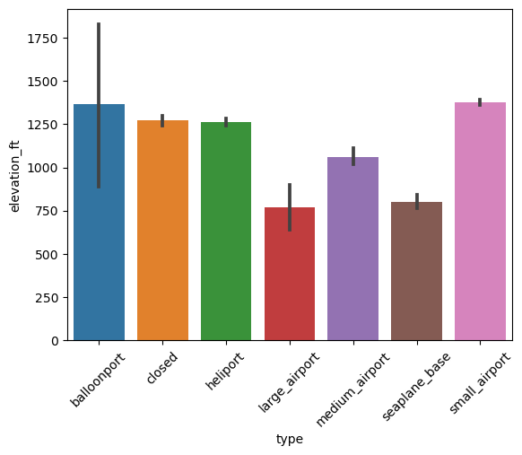
Graphical representation of numerical attributes

Slide 15
Normalize the dataset
Normalization is a method which is usually applied as a part of data preprocessing for machine learning models. The major goal of normalization is to transform features to be on a similar scale. This helps to improve the performance of a model by scaling the features

Slide 16
Min-Max Scaling
Min-Max Scaling:
Normalization with Min-Max Scaler is a data preprocessing technique used to scale numerical features to a specific range, typically [0, 1]. It is one of the most straightforward scaling methods and is commonly applied to ensure all features have similar scales. Min-Max scaling preserves the relative relationships among data points.

Slide 17


